Slide 1
Research Methods in behavioral sciences
Manas K. Mandal

Slide 2
Natural & social sciences
Both sciences employ same scientific methods / models
Both employ general laws that govern nature or nurture
Both employ empirical & measured data as evidence
Both employ experimental data in laboratory conditions / natural settings
Social sciences largely operate in an open system where variables are not controllable every time
Therefore social sciences use a variety of research methods

Slide 3
Application
Control
Explanation
Prediction
Description
Subjective Interpretation of Qualitative Data
Relative Nature of Tools
Lack of Absolute Zero Point
GOALS OF ENQUIRY
LIMITATIONS OF ENQUIRY
ISSUES IN RESEARCH METHODS
STEPS IN RESEARCH
ETHICAL ISSUES
MAJOR METHODS
Strategy
Observation
Heuristics
Voluntary Participation
Sharing the Results of the Study
Experimental
Logistics
Survey
Case Study
Tactics
Informed Debriefing
Consent
Simulations
Statistics
Tests
Communication

Slide 4

Quantitative research
Hypothetico-deductive
Assumption of objectivity
Reliability, validity
Limiting researcher ‘bias’

Slide 5

Qualitative Research
Collection and analysis of non-numerical data through a social-scientific lens
Major concern is about how do we produce inner experience

Slide 6

Specific steps in research
Selection of a topic (research concept, construct and variables)
Survey of literature (source identification)
Statement of a problem (stating the variables in logical terms)
Operationalization of variables (assigning meaning to a variable by specifying the operations necessary to measure it)
Statement of hypothesis (tentative solution that is empirical, testable and operationally definable: Exploratory – Confirmatory, Null - Alternative)
Control of variables (Experimental – Statistical)

Slide 7

Selection of a research design (Experimental– Correlational
Sampling and assignment of subjects to variables (Probability – Non-probability sampling)
Procedural steps
Selection of statistical tools (Qualitative – Quantitative, Parametric – Nonparametric)
Making inferences and generalization of findings
References

Slide 8

Methods of Measurement
Self-report, social media
Projective technique
Nonverbal-expressions
Hormones
Electro-physiology (EEG)
Neuroimaging
Thought listing
Experience sampling
Life events

Slide 9
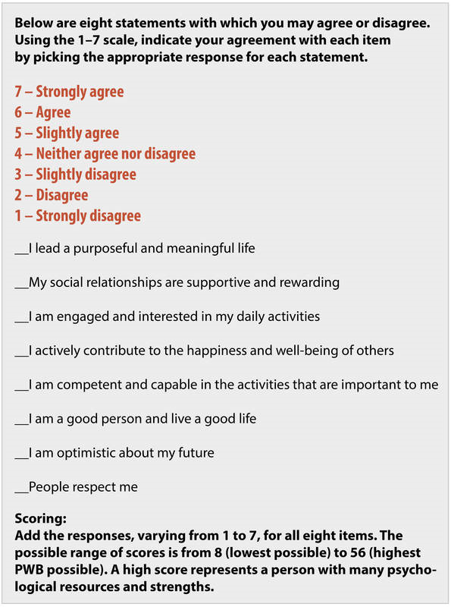
Diener, 1984

Slide 10

Nonverbal response

Slide 11

Survey design…
Theoretical approach: based on utilitarian needs, authentic happiness or subjective well-being
Survey planning: group composition, work break-down
Study method: based on survey technique
Selection of survey frame: IIT Kharagpur with all Halls under the study frame
Selection of domains: based on literature, expert opinion, & exploratory data from pilot survey
Structure of questionnaire: Formal standardized questionnaire with domains of study defined
@Manas K Mandal

Slide 12
Survey design…
Design of questionnaire: based on domain definition, target respondents, content & format, pre-test, & length
Method of reaching target respondent: personal /group interview, mailed interview, telephone
Questionnaire structure: First person, simple structure with ‘prompt’, jargon-free, color code for anchors
Response structure: 3-5-7-point interval scale with anchors defined only
Study design: probability sampling with each unit’s probability of inclusion [stratified random sampling]
@Manas K Mandal

Slide 13
Determination of Happiness index…
Data collection: interview assisted, paper based, computer assisted
Coding: error prevention mechanism, acceptable limits
Editing & Imputation: Outliers, value replacement limits
Data analysis: descriptive & inferential statistics
Happiness index: standard score (Z, %)
@Manas K Mandal

Slide 14
PLAN OF A STUDY
Univariate / bivariate
Qualitative analysis
Content analysis
Quantitative analysis
Descriptive
Inferential
Mean
Median
Mode
Central Tendency
Parametric
Nonparametric
Range
QD
AD
SD
Regression
Analysis
Association
Dispersion
Difference
Association
Factor
Analysis
Two Variables
Single Factor
Multi Factor
Pearson’s ‘r’
Spearman’s rho
Biserial, Point Biserial
Tetrachoric, Phi Coefficient
More than Two Variables
Correlation
Within Group
Within
Group
Between
Group
Difference
W
Between Group
P
One sample
χ²
t
Two levels
RBF_{D}
CRF_{D}
Two samples
Related
More than Two levels
MIXED_{D}
Independent
F
K samples

Slide 15


Important issues
Significance of the research question
Reliability and validity of the instruments
Testability of hypothesis with the research design
Representativeness of sample
Ethical standards

Slide 16
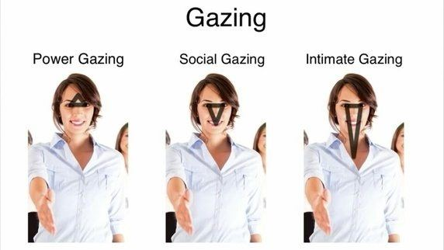


Slide 17
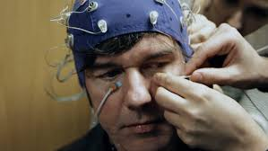
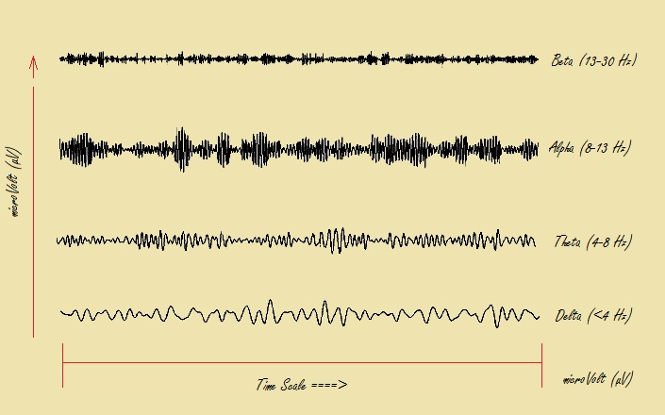
Electroencephalograpy

Slide 18

Qualitative research
Non-traditional paradigm, non-specific rules
‘Data display method’
Sensitivity to context
Commitment [prolonged engagement]
Transparency [disclosure]
Coherence, impact [social, cultural]
Different from content-analysis

Slide 19

Interpretative Phenomenological Analysis
How participants make sense of their personal & social world
Idiographic method [case study]
Semi-structured interviewing & clustering of themes
Questions:
What makes us happy – Context (society) – content (gene) – intent (self)?
How do children describe their happiness?

Slide 20
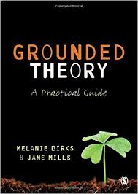
Grounded Theory
Explore experience not rooted in a ‘grand’ theory [death & dying]
Challenge existing theory with an aim establish a ‘new’ theory
Interview, group discussion, focus group
Questions:
Does happiness regulate our biology?
Do optimists live longer than pessimists?

Slide 21

Discourse Analysis
How social reality is linguistically constructed [study of social texts]
Actions & beliefs are linguistically done
Letters, newspaper reports, interview transcripts
Question: Do we make selective estimation error about judging happiness in people?

Slide 22

Narrative analysis
How do we construct our concept of self & others?
Self-interpretation is done in relation to others in community
Autobiography, Story [a process of identity construction]
Question: How elderly people describe happiness with their autobiographical narratives?

Slide 23
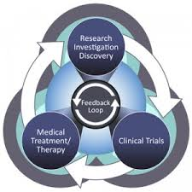
Pitfalls
The prediction urge
The simplification urge
Illusory expertise
Sloppy execution
Overselling
Error & bias

Slide 24

Purpose of content analysis
To identify the intentions and other characteristics of communicator.
To determine the psychological state of persons /groups
To obtain political and military intelligence.
To reflect attitudes, interests and values (cultural patterns) of population groups.
To reveal the focus of attention
To describe attitudinal and behavioral responses to communications .

Slide 25

Research designs…
Action research: undertaking some form of interventionary research…iterative, cyclic process…till a solution is achieved
Case-study: in-depth study about a problem rather than sweeping statistical survey…detailed contextual analysis of limited event
Causal relationship: independent variable bringing a change in outcome variable…empirical association (correlation), time order, nonspuriousness
Descriptive design: to describe what exists with respect to a variable…does not make conclusion
Observational design: to draw conclusion through observation, direct or indirect…avoids ethical & practical difficulties

Slide 26
Research designs…
Cohort design: study conducted over a period of time in subjects who are united by some commonality or similarity (rather than in general population)…open, closed cohort
Cross-sectional design: examine differences from among subjects, based on existing difference, rather than on random allocation… no time dimension, reliance on existing difference
Longitudinal design: to follow same sample over time & make repeated observations
Experimental design: to render control on all such variable that may influence dependent variable…experimental & control groups
Meta-analytical design: to systematically evaluate & summarize the results from a number of studies

